Slide 1
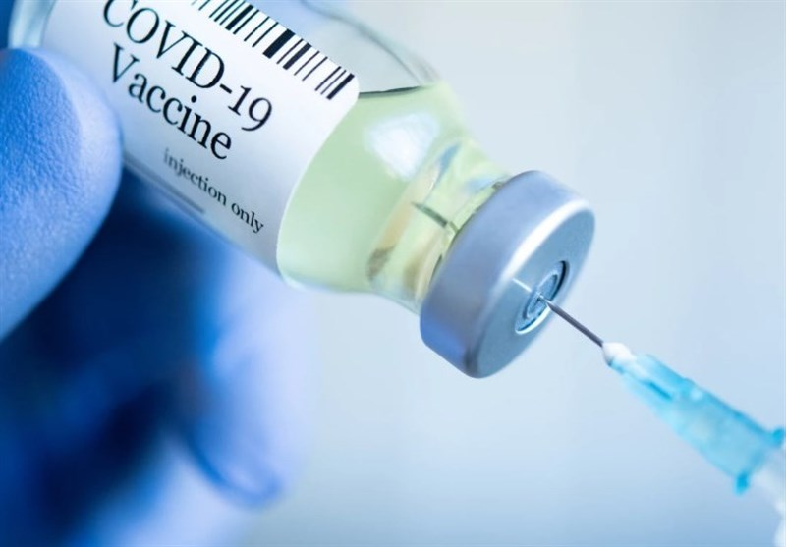
Covid 19 Vaccine Information
Please do not ring your GP surgery.
We will ring or text you when we are ready
and have the appointments available to book.

Slide 2
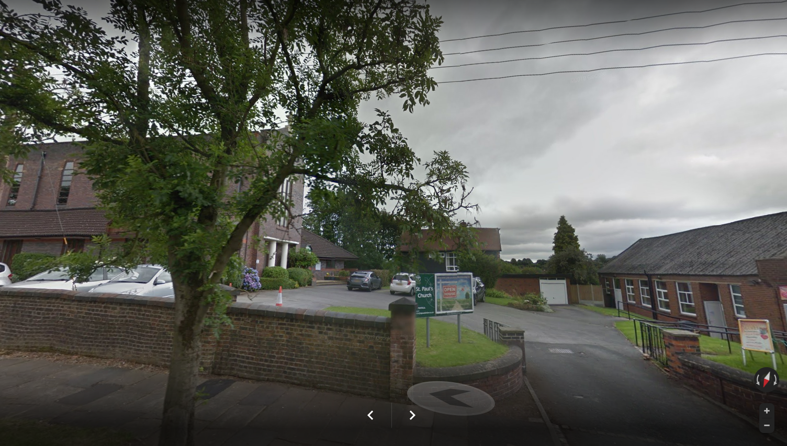
Your local Covid 19 vaccination centre will be St Paul Church - 131 Longton Hall Road
We will start vaccinating from week commencing
11th January 2021
This will be by appointment only
starting with patients
over the age of 80
(other age ranges will be invited shortly)

Slide 3
Vaccination Clinic Important Information
If you have any covid symptoms DO NOT ATTEND, please cancel and rebook your appointment.
Please arrive on time but not early - as there is no indoor queuing.
There is additional parking at the rear of the church.
Please attend alone where possible.
Please wear a face covering.
Please wear a short sleeve top under your coat.
Clinics will be socially distanced.
There will be a separate entrance and exit.
Staff will be wearing full protective clothing.
After having the vaccination you should wait in the hall for 15 minutes.

